Slide 1
Tweets Are Forever
A Large-Scale Quantitative Analysis of Deleted Tweets

Slide 2

Notes:
http://b-i.forbesimg.com/kashmirhill/files/2013/04/300px-Sm_team_tweets_logo7.png

Slide 3
Tweets Are Forever
A Large-Scale Quantitative Analysis of Deleted Tweets
Almuhimedi, Wilson, Liu, Sadeh, Acquisti
Presenter: Aditya Shirode

Slide 4
BACKGROUND
Researchers at CMU
Presented in Feb 2013 at Computer-Supported Cooperative Work and Social Computing Conference
Motivated by their own research of designing intervention techniques that “nudge” users to avoid posting tweets that they might regret in the future
First large-scale study of deleted data from a social network
Notes:
Paper presented on Facebook nudges by an adjoining group from CMU
Similar studies prior to this had dataset of about 200,000

Slide 5
APPROACH
Tracked public tweets of users using Twitter API and observed large-scale patterns in deletion behavior
Took the empirical approach
Examined aggregated properties for tweets - Connections to other tweets, clients used, temporal aspects of deletion, geotagging information
Used Chi-squared statistical test on all data sets to label the significance of differences
Notes:
Continuous one week period - March 14-20, 2012
1.6 Million Tweets of approx 292000 Twitter users
Empirical approach - Instead of interviewing users and asking them to recall recent regret incidents, they take a “in-field” approach by collecting users’ deleted tweets
Data sets after applying Bonferroni Correction

Slide 6
THEIR RESEARCH QUESTIONS
What differences exist between deleted and undeleted tweets?
Location tags, reply frequencies, specific sentiment/ topic
How often are tweets deleted for superficial reasons?
Typos, rephrasings, spams, mass deletions
What are some of the additional reasons that people delete tweets?

Slide 7
RELATED WORK
Most of the previous work focused on the content of tweets
Aether - A system by Pehr Hovey gave a tool for real-time recovery and visualization of deleted tweets
Refer to studies done on Facebook posts for deletion behaviors, reasons for deletion, temporal factor
Notes:
Aether - Master’s Thesis 2010 University of California

Slide 8

TWITTER
Online Social Network started as SMS of the WEB
140-character long messages, known as Tweets
A user can follow other users to easily receive their tweets in an aggregated news feed
Can post tweets with links, images, with location metadata
Engaging in conversation
Mentioning a user (@username), retweet, assign a topic (#topic)
Notes:
By default, all tweets are public and accessible by anyone; but a user can protect their account and tweet to a group of chosen followers

Slide 9
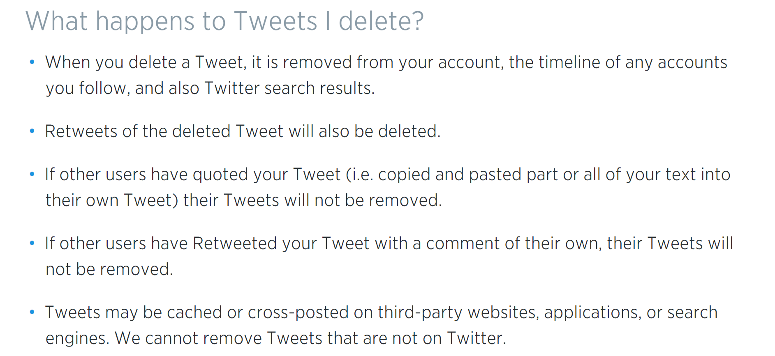
TWEET DELETION

Slide 10
TWEET DELETION
Deleted tweet disappears from user’s timeline, his/her follower’s timeline, from search results on twitter
A status deletion notice is distributed via the Twitter streaming API to relevant users’ clients so that they, in turn, remove deleted tweets from their records
There is a short delay (Even the official website has a note saying -
Note: Deleted Tweets sometimes hang out in Twitter search, they will clear with time.)
No bulk deletion of tweets; but one-click bulk deletion of location data
Notes:
“You can never truly take something back online”

Slide 11
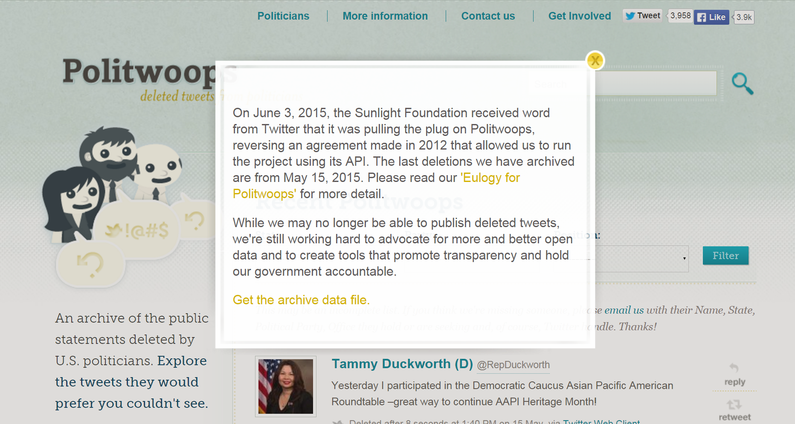
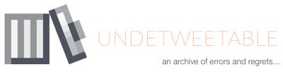
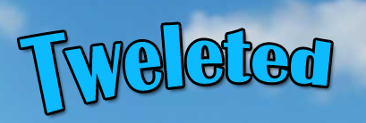
Notes:
Tweet archivers
Twitter has taken action against other tweet archivers (Undetweetable, Tweleted)
Earlier this year, took down Politwoops (A service dedicated to storing and recovering tweets deleted by politicians) (http://politwoops.sunlightfoundation.com/)

Slide 12
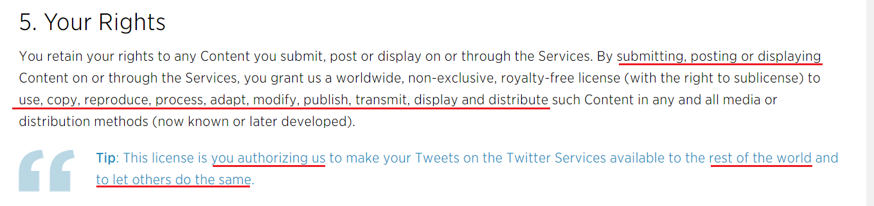
TWITTER - TERMS OF SERVICE
Notes:
https://twitter.com/tos?lang=en

Slide 13
SELECTION OF USERS
Account at least a month old, at least 10 tweets, at least 10 followers and 10 following, first tweet received through the API for the user was English (Used Google Translate)
Collected all public tweets, retweets, replies
Other metadata as - Hashtags, URLs, user mentions, location information
They also gathered their persistent undeleted tweets for the same users (previous tweets)

Slide 14

Notes:
How many have used twitter? Are on Twitter? Have tweeted? Have deleted a tweet/ retweet? Have used geotagging?
Terms - Deleted-undeleted tweets, Deletion active users (Tweeted and deleted at least once during that period)
Deletion notices sent by Twitter API for tweets as well location data allowed the division of dataset into deleted and undeleted
Out of 67.2 Mil tweets, 65.6 Mil (97.6%) Undeleted, 1.6 Mil (2.4%) Deleted
b/g image link - http://mike.teczno.com/img/raffi-krikorian-map-of-a-tweet.png

Slide 15
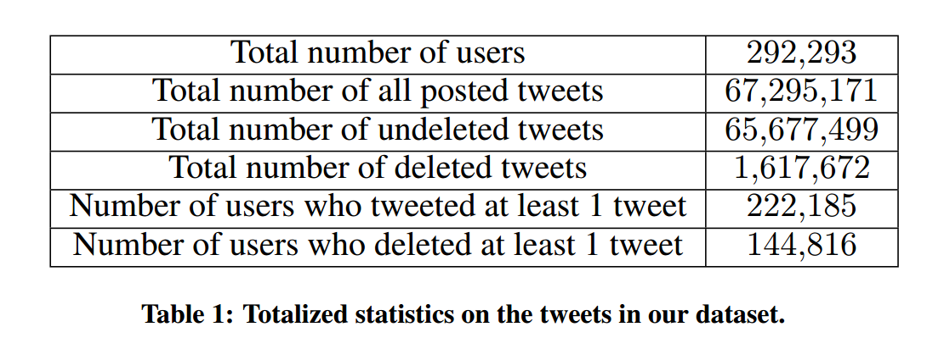
SELECTION OF USERS
Notes:
Out of 67.2 Mil tweets, 65.6 Mil (97.6%) Undeleted, 1.6 Mil (2.4%) Deleted
Out of 292293 unique users, 76% had tweeted at least once, 49.5% had deleted at least one tweet during the monitoring period
Out of all the users who posted a tweet during the time, only 65% of them deleted at least one tweet during that same week
Two unusually active deleters - a bot account and a user who seemed in ambivalent condition about retweets made by him/her

Slide 16
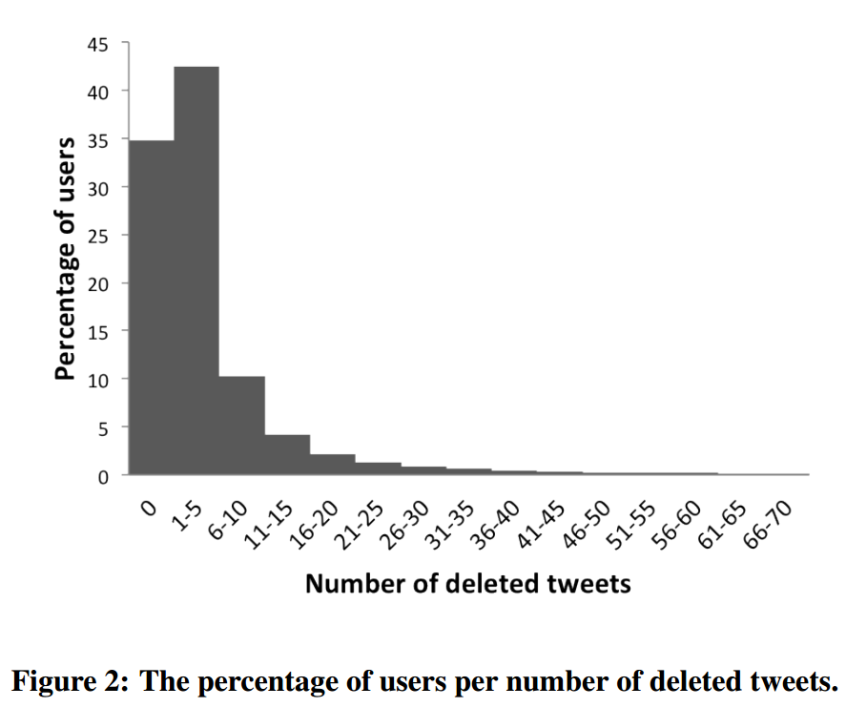
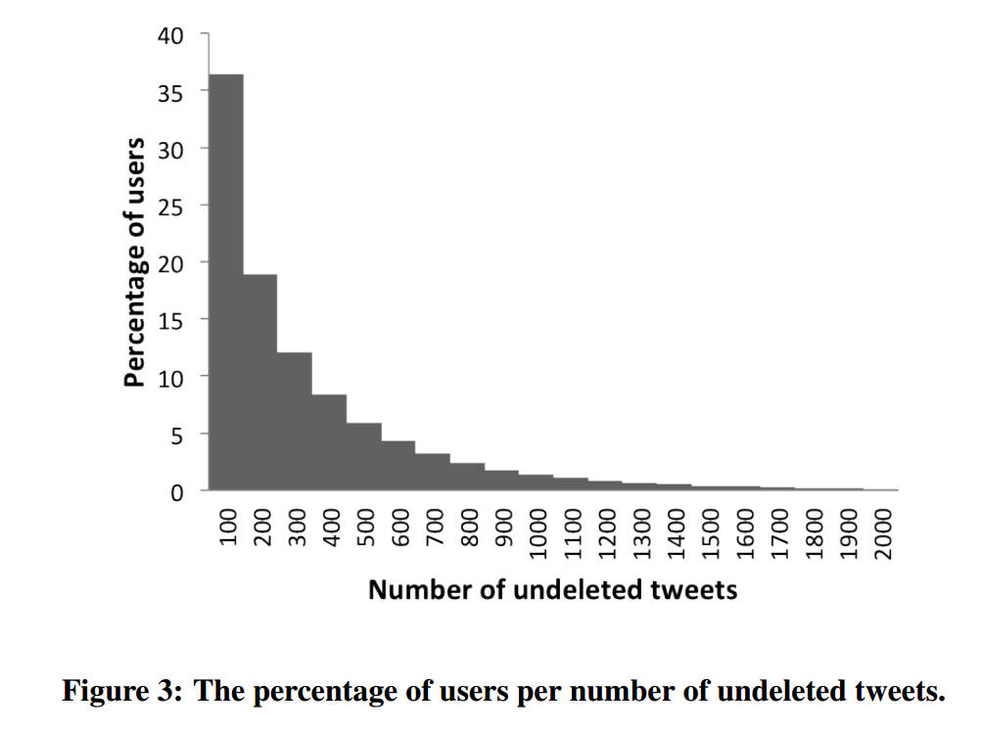
DELETED TWEETS AND UNDLETED TWEETS
Notes:
Out of 67.2 Mil tweets, 65.6 Mil (97.6%) Undeleted, 1.6 Mil (2.4%) Deleted
Out of 292293 unique users, 76% had tweeted at least once, 49.5% had deleted at least one tweet during the monitoring period
Out of all the users who posted a tweet during the time, only 65% of them deleted at least one tweet during that same week
Two unusually active deleters - a bot account and a user who seemed in ambivalent condition about retweets made by him/her

Slide 17
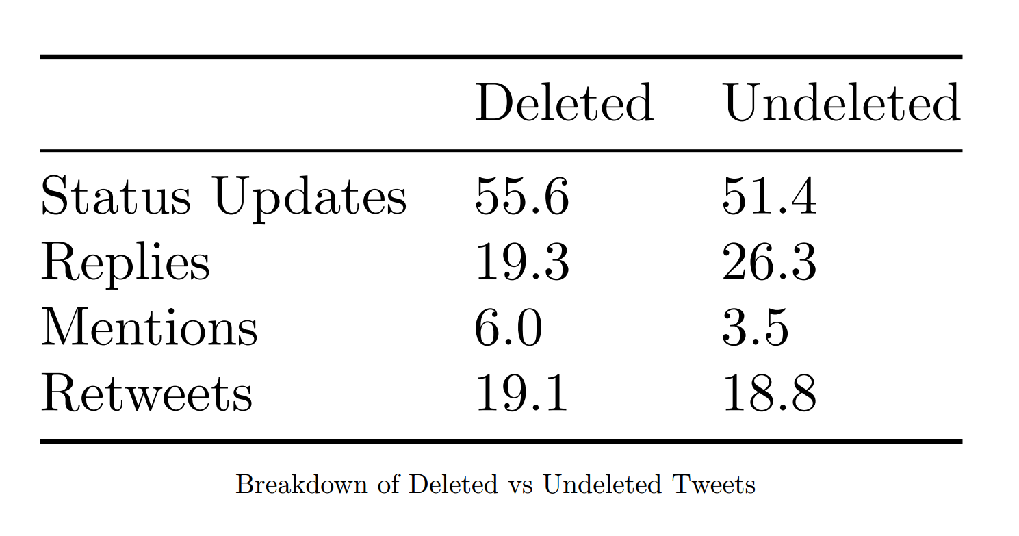
DELETED TWEETS
Notes:
4 categories - retweets, replies, mentions, status
Status updates are more likely to be deleted

Slide 18
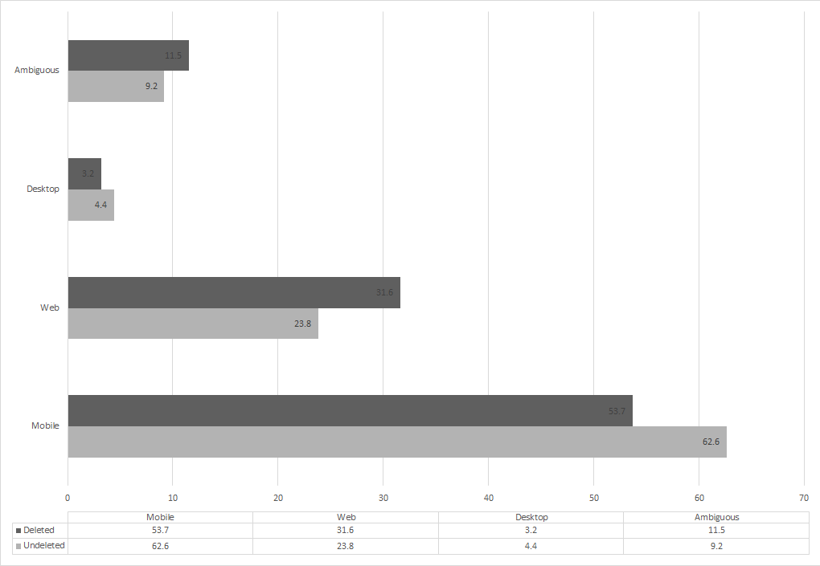
SOURCE OF DELETED TWEETS (Client Comparison)
Notes:
Top 5 Twitter clients during the study period -
Web, Twitter for Android, Twitter for iPhone, Echofon, Twitter for BlackBerry
Deleted tweets from 1252 unique clients vs 3395 for undeleted
99% tweets were from 110 and 132 unique clients
They had hypothesized that the percentage of tweets deleted would be significantly higher from mobile devices, due to the challenges of posting (e.g., difficulties with entry methods, cognitive burden from one’s surroundings). However, this was not the case, as deletion instead consumed a greater fraction of tweets posted from non-mobile sources.

Slide 19
REPLIES TO TWEETS
Deleted Undeleted
Initiated conversations 11% 27%
A single reply 89% 93%
Mean of replies 1.2 1.1
Most of the replies to deleted tweets were spams (Follow for followback)
A more, in-detail analysis of the contents of conversation should be done
Notes:
A more, in-detail analysis of the contents of conversation might give a better perspective
2.9% of tweets with 0 replies were deleted
1.0% of tweets with 1 replies were deleted
May suggest that tweeple are reluctant to delete their posts once they’ve received replies OR tweets that provoke replies tend to contain content user is less likely to delete

Slide 20
SUPERFICIAL DELETIONS
Typos/rephrasing 17%
Spam 1%
People usually correct
misspellings, missing mentions, missing hashtags, semantic substitutions, rephrasing in a milder way
Spam observed by manual classification of tweets (Requires work)
Notes:
For K subsequent tweets, they used Levenshtein distance to find edit distance to detect misspellings and cosine similarity to consider word-level similarity
Optimal: Edit distance of 5, Cosine similarity of 0.6, Scanning memory of K=3
Spam - Extreme use of @ and #; follow for followback

Slide 21
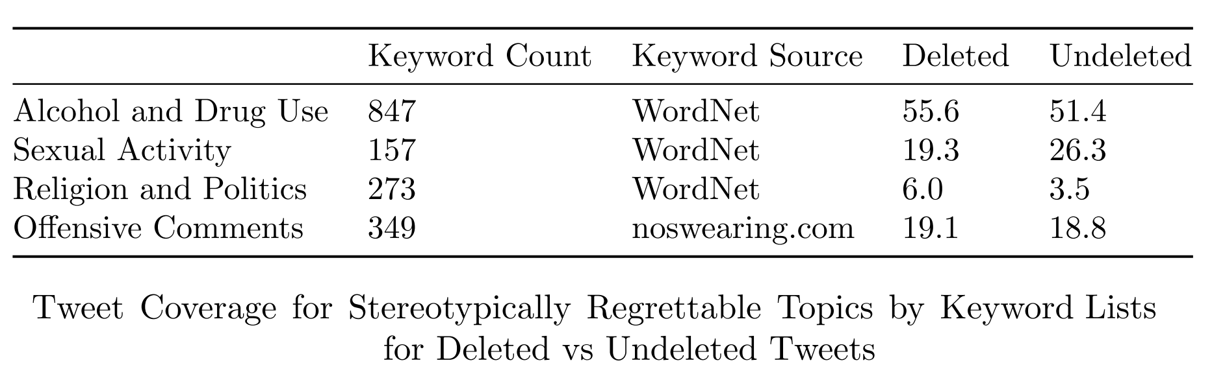
REGRET IN TWEETS
Hypothesized that some stereotypically regrettable topics might appear with greater frequency in deleted tweets than in undeleted tweets
Notes:
Approximately for 10000 randomly selected tweets; words were stemmed

Slide 22
REGRET IN TWEETS
Both sets seem equal in occurrences, because some words might have had different meaning in the context, and hence labelled incorrectly
Notes:
Need of advanced methods is required to detect subtle differences

Slide 23
REGRET IN TWEETS - SENTIMENT ANALYSIS
2000 most frequently occurring words from deleted and undeleted tweets were considered against AFINN-111 (An annotated list of sentiment expressing words for online sites)
Differences were expected to be subtle, because of wide variety of topics in such big number of tweets

Slide 24
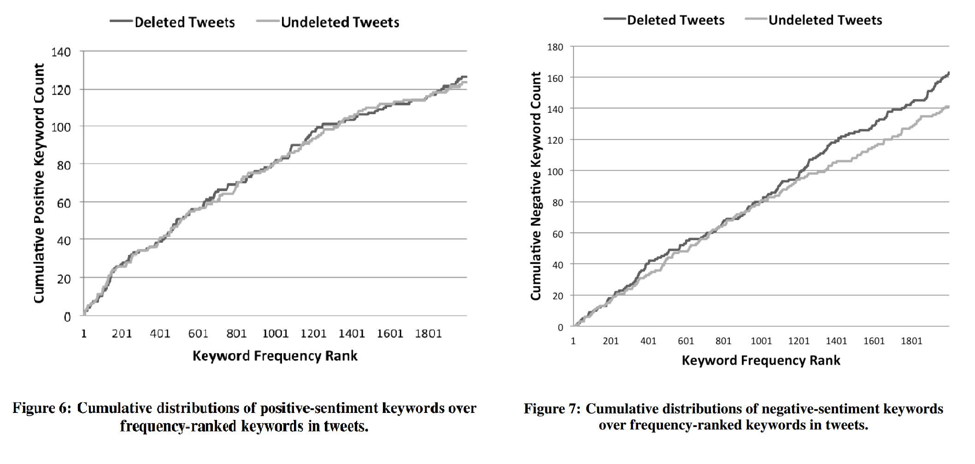
REGRET IN TWEETS - SENTIMENT ANALYSIS
Notes:
Differences were expected to be subtle, because of wide variety of topics in such big number of tweets
Deleted tweets share much of the same sentiment vocabulary with undeleted tweets, although there is a possibility of more negative words in the long tail of the frequency distribution

Slide 25
TEMPORAL ANALYSIS OF DELETED TWEETS
Posted 100 tweets and deleted them immediately at different times of day to record times for posting, deletion, and receiving deletion notices
Conclusion - Average time difference between deleting a tweet and receiving its deletion notice is negligible

Slide 26
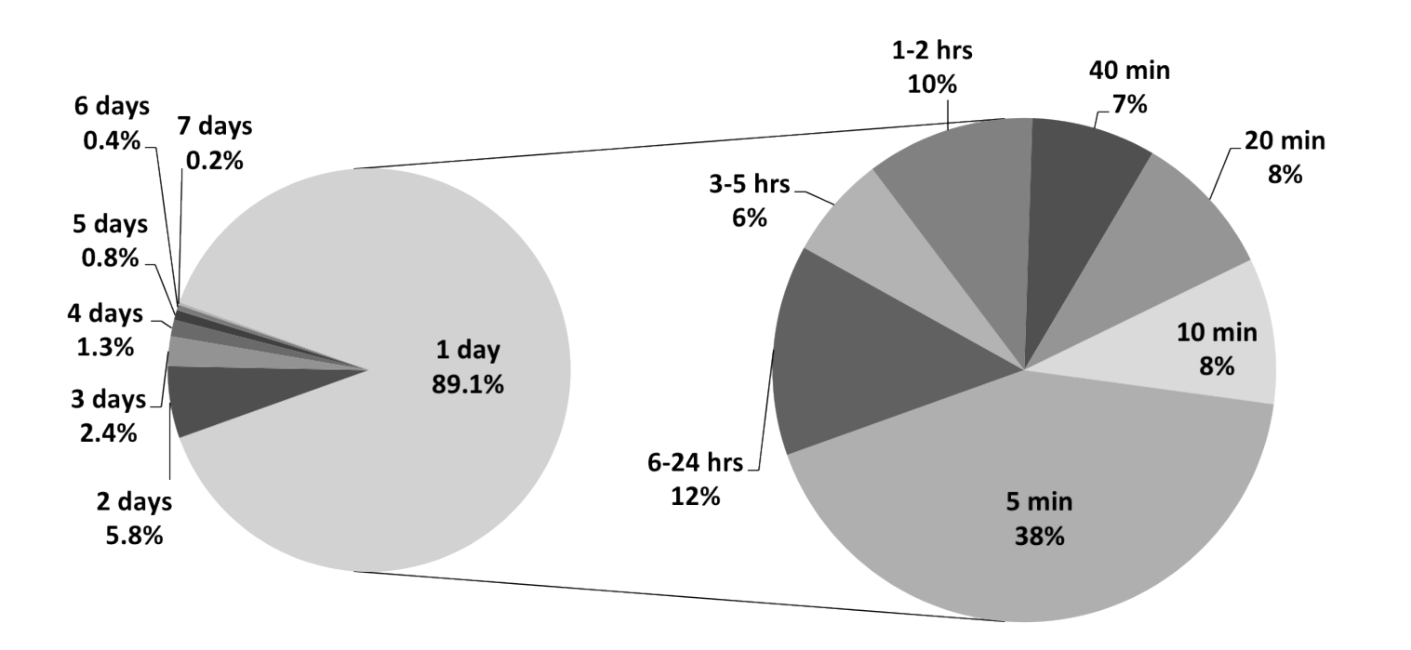
HOW FAST IS A TWEET DELETED?
Notes:
17% deleted within 30 secs, 22% within a min, 58.6% within 30 mins, 65.2% within an hour
Average 8.45 hours, std deviation 20.85 hrs
Typos were fastest to be deleted (Mean two hrs, sd 10 hrs)
Spam (Mean 5 hrs, sd 11 hrs) (Might be because the spammers repost the same tweet so that it stays at top in the feed)
Other categories (82% of deleted tweets) (mean 10 hrs, sd 10 hrs)

Slide 27
TEMPORAL ANALYSIS OF DELETED TWEETS
Hypothesized that the rate of tweet deletion might increase on the weekends
The rate was indeed greater than average on Saturdays and Sundays (Cannot pinpoint the exact reasons behind this)
Deleted Tweets - 15.7% on Sunday (Largest) 12.9% on Tuesday (Smallest)
30% on Weekends 70% on Weekdays
Most spam on Thursday (15.3%)
Most typos and rephrasings on Sunday (15.3%)

Slide 28
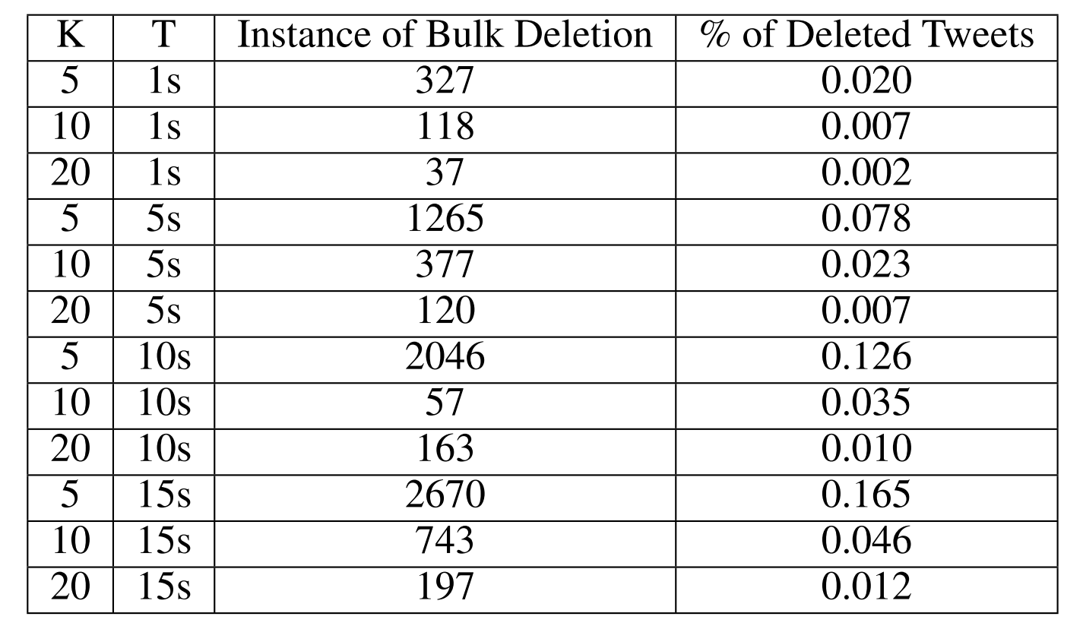
BULK DELETION OF TWEETS
Twitter does not provide a bulk-deletion operation for one’s tweets, and some third party applications have been developed for this purpose -
Tweeteraser, TwitWipe, Delete Multiple Tweets, Delete My Tweets, Delete Your Tweets and Tweeticide
Notes:
To detect bulk deletion, they created a chronological record of each user’s deletions and analyzed thresholds of time differences between deletions (No of tweets K deleted must be large; Time elapsed T must be small as process is automatic)
Maximum tweets deleted together in a considerably short time span is 5 (So no bulk deletion observed)

Slide 29
SPATIAL ANALYSIS OF DELETED TWEETS
Deleted Undeleted
Tweets with Location Data 23% 77%
Mean per user 3.5 40
53.7% of deleted tweets were from Twitter’s Official Mobile Clients
Observed instances of bulk deletion of location information

Slide 30
SPATIAL ANALYSIS OF DELETED TWEETS
Hypothesized that deletion rates would vary depending on the locations at which tweets are posted
Tested this using Foursquare API, which provides a reverse geocoding service to translate location information (i.e., longitude and latitude) into venues
Possible to assign these venue categories to locations associated with -
Deleted tweets 7,604 (89% of all deleted tweets with locations)
Undeleted tweets 423,673 (86% of all undeleted tweets with locations)

Slide 31
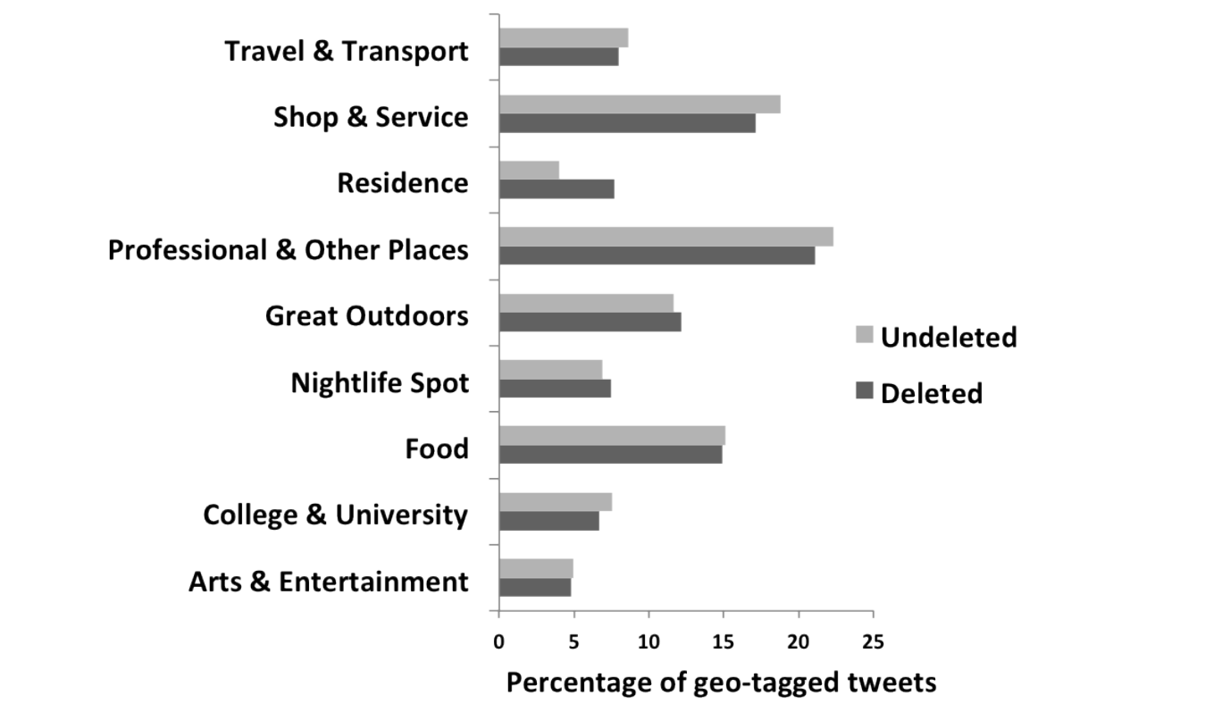
SPATIAL ANALYSIS OF DELETED TWEETS
Notes:
The percentages of deleted and undeleted tweets in the “Residence” category differ the most from others (respectively 7.7% and 4%)
Chi^2 = 258.5, df = 1, p-value <0.05

Slide 32
REVISITING THE RESEARCH QUESTIONS
What differences exist between deleted and undeleted tweets?
Substantial for distributions of clients used to post tweets, the locations of posts (determined via FourSquare), and the quantities of replies
Inconclusive for sentiment vocabulary and connection of community via mentions and retweets
Quite similar for distributions of stereotypically regrettable topics (Needs to be revisited)
How often are tweets deleted for superficial reasons?
Together, typos, rephrasing, and spam account for 18% of deleted tweets
Bulk deletions comprise a tiny fraction
What are some of the additional reasons that people delete tweets?
Tweets from residences seemed more likely to be deleted (Reflect location privacy)
Tweets from web clients were more likely to be deleted (suggesting they are often the source of unwanted tweets)
Notes:
About 2.4% of all tweets are deleted
About 50% of all users deleted at least one tweet during the week-long monitoring period
Deleted and undeleted tweets are largely similar in terms of content, weekday and weekend volume, and volume of tweets with location information attached

Slide 33
CONCLUSION
The availability of deleted tweets raises security and privacy implications, both from tweets’ textual contents and their location tags
It is incumbent upon Twitter to ensure that users are aware of limitations of deletion
Users have the “Right to be forgotten”

Slide 34


PROS
Well Structured
Large Dataset
Mentions where the study fell short
Determined statistical significance; gave data to contrast with for further studies
Easy read
WHAT COULD’VE BEEN BETTER
One week is a good start; but needs to be studied over a longer period
No follow-up paper

Slide 35
WHAT NEXT ?
Twitter-tailored spelling detection and correction
Nudges for Tweets (?)
Devising methods and laws so that deleted tweets would not be archived

Slide 36
QUESTIONS ?

Slide 37
THANK YOU FOR LISTENING

Slide 38
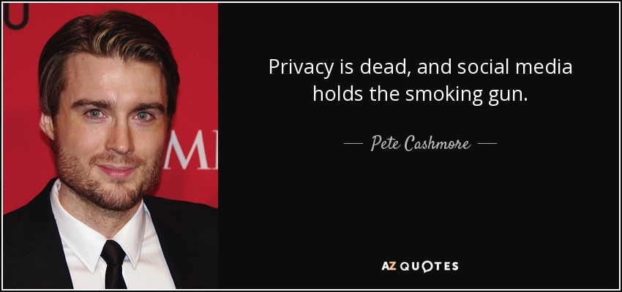
Notes:
Mashable CEO
http://www.azquotes.com/picture-quotes/quote-privacy-is-dead-and-social-media-holds-the-smoking-gun-pete-cashmore-67-87-86.jpg

